Slide 1
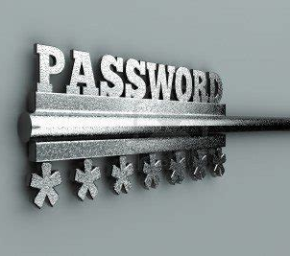
Protect Your Passwords
John York
August 11, 2020

Slide 2
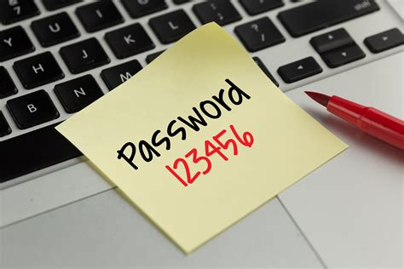
Protect Your Passwords
Common password mistakes
Common password attacks
Password Selection
Password Managers
Two Factor Authentication

Slide 3
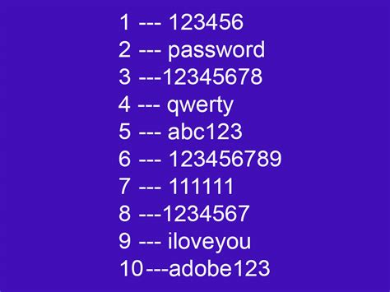
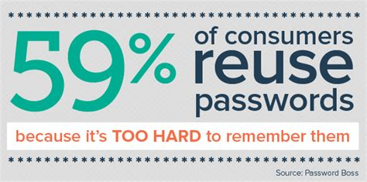
Common Mistakes
Easy to guess passwords
Password reuse

Slide 4
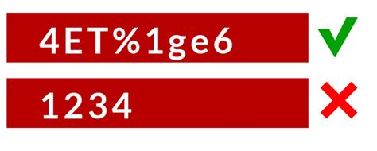
Common Password Attacks (1)
Brute force attack
Use a dictionary of common passwords
Try every password until one works
Defense—account lockout
Attack your organization (jargon: password spraying)
Try one common password against every account
If no account logs in, try again with another password
Primary Defense: long, random passwords

Slide 5
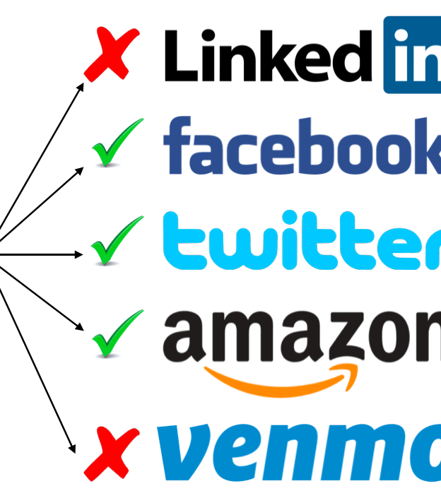
Common Password Attacks (2)
Use usernames/passwords from recent breaches (jargon: credential stuffing)
Try credentials against common sites
Effective—Disney+
Note: Good sites store hashes (fingerprints) and not plain text passwords
Attackers ‘crack’ hashes by trying passwords from a dictionary. Success go into username/password list from 1st step
Defense—Don’t Reuse Passwords!
Defense—Long Random Passwords!

Slide 6

Common Password Attacks (3)
Steal password from compromised computer
Defense—Don’t reuse passwords

Slide 7
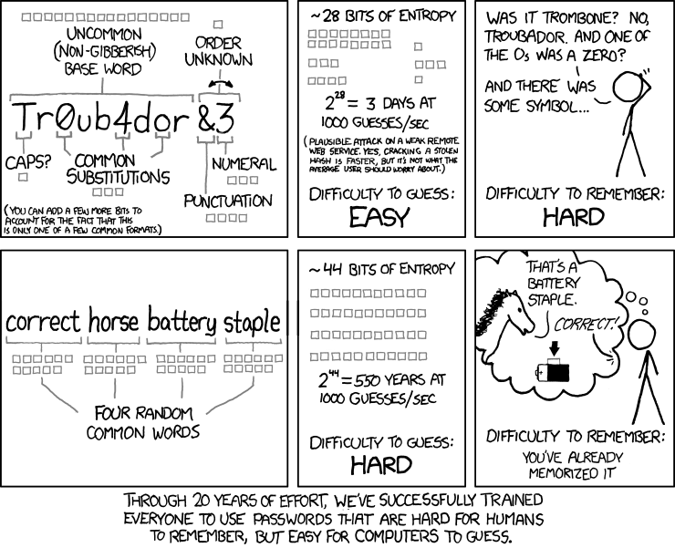
Password Selection
Make Passwords Long >15 characters (20 or more is better)
Random is still best
“How do I remember passwords for my 42 accounts when they are all different and all long?”

Slide 8
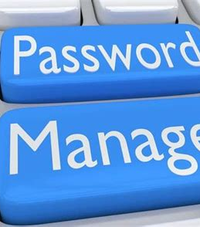
Password Managers
Save passwords in an encrypted database
Remember one long nasty password
Generate separate long random passwords for all accounts
Google ‘password manager’ for choices
Safest managers do not use your web browser, as browsers are often hacked
KeePass and 1Password have good reputations

Slide 9
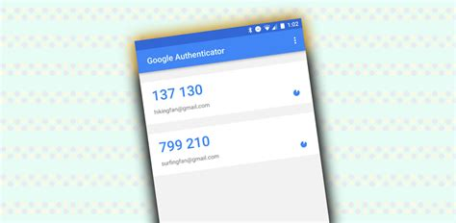
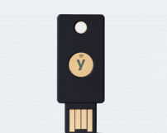
Two Factor Authentication (2FA)
Also called Multifactor Authentication (MFA)
1st Factor is your password
2nd Factor is your phone or token
In crypto terms, “something you know” and something you have”
Still hackable, but much, much harder to attack than a simple password
Google Authenticator, Microsoft Authenticator, YubiKey, RSA token

Slide 10

2FA problems
No single method works across all sites
Methods that send a text to your phone can be attacked
Attacker calls phone company and steals your number
Jargon: SIM Swapping
Use a PIN on your account with your phone vendor
Better than not using any 2FA, however

Slide 11
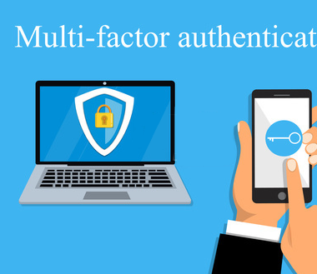
Key Lessons & Recommendations
Passwords should be LONG
Passwords should be as random as possible
Never reuse passwords
1 account = 1 password
Use a Password Manager
For accounts you care about (banks, email, etc.) use 2FA

